Slide 1
Student database & query
TEAM :
Eswar Naidu
Neha
Suleman
Subodh Kumar
Gaurav Mishra

Slide 2
CONTENTS :
What is ORC.
Project Description
Flow of Project
Table in the Project
Fetching data from Enquiry table to other tables.
Quries For Updating A New Record

Slide 3
What is ORC ?
The Optimized Row Columnar (ORC) file format provides a highly efficient way to store Hive data. It was designed to overcome limitations of the other Hive file formats. Using ORC files improves performance when Hive is reading, writing, and processing data.
a single file as the output of each task, which reduces the NameNode's load.
block-mode compression based on data type
run-length encoding for integer columns
dictionary encoding for string columns

Slide 4
Project Description
This is a project which is created in hive.
The project was to create and maintain a database for candidate enrollment where they provide training for various courses .
In this project we have created eight tables.
We have performed various operations in this project like table join , partitioning, updation etc. We have also performed queries in tables where we have extracted the data from it.
We have run this project in hive terminal in GCP.

Slide 5
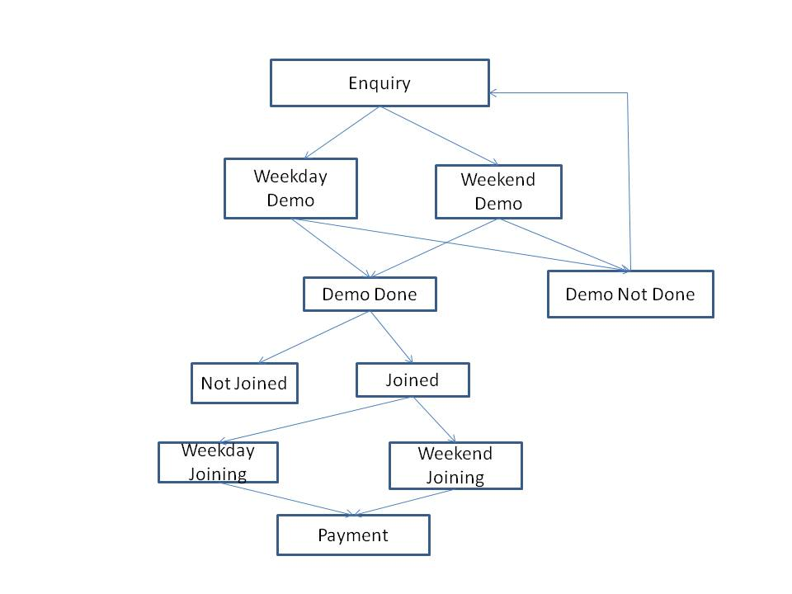
Project Flow

Slide 6
Tables in the Project
Enquiry Table
DEMO_SCHEDULE table – WEEKDAY_DEMO and WEEKEND_DEMO Table
DEMO_MISSED Table
COURSE_ENROLL – WEEKDAY_JOINING Table and
WEEKEND_JOINING Table
NOT_JOINED Table
Payment Table

Slide 7
Enquiry Table
We, have created the master table with the attributes Name, age, Email, Mobile_no , Course, Fee, Discount, Demo_Date, status_final which is our ORC table
Loaded the data from local.
Query to create a table
create table enquiry(Name string, Age int,Email string,Phone string,Course string,Fee int,Discount int,Demo string,Status string) clustered by (Course) into 5 buckets stored as orc tblproperties('transactional'='true');

Slide 8
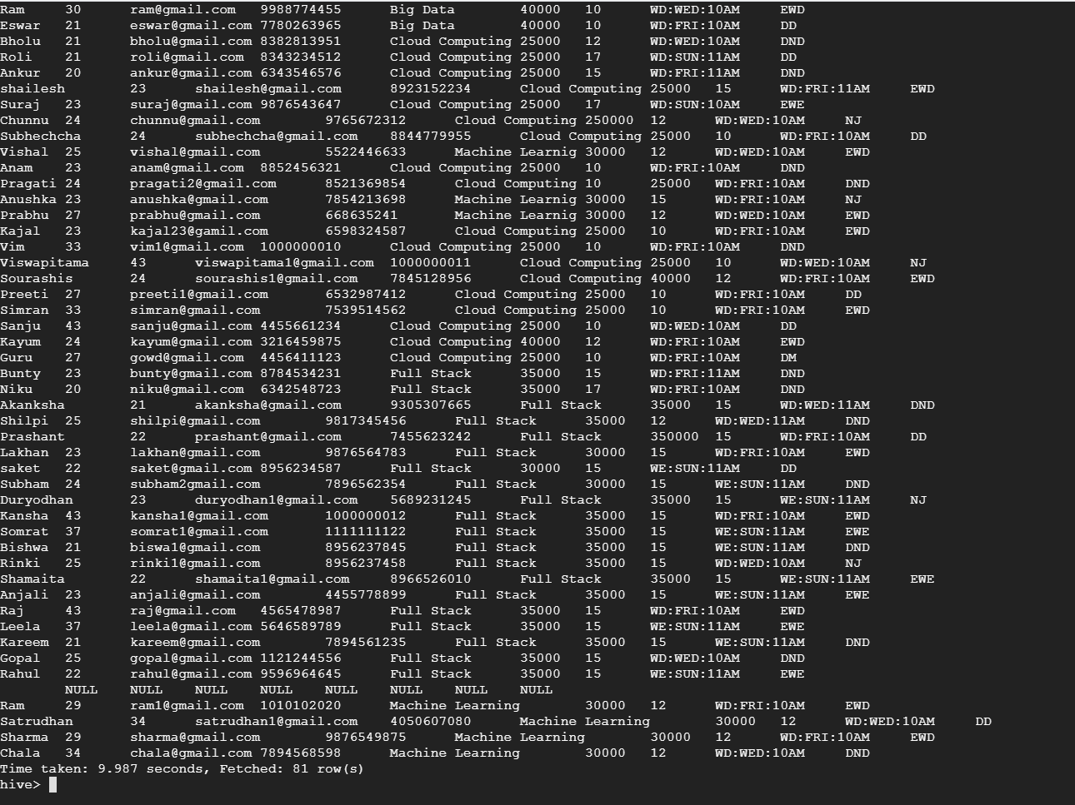
Enquiry Table

Slide 9
Weekday Demo_Schedule table
It is taken from enquiry table who has scheduled their demo with added attributes like demoday (WD,WE) ,day ,time.
Query:
create table weekday_demo(name string,age int,email string,phone string,course string,demo_day string,demo_time string) clustered by (course) into 5 buckets stored as orc tblproperties('transactional'='true');
We have used substr operator for extracting demo day and time from enquiry table where demoday is weekday.
Command for joining:
insert overwrite table weekday_demo select name,age,email,phone,course,substr(demo,4,3) as demo_day,substr(demo,8,4) as demo_time from enquiry where substr(demo,1,2)=='WD';

Slide 10
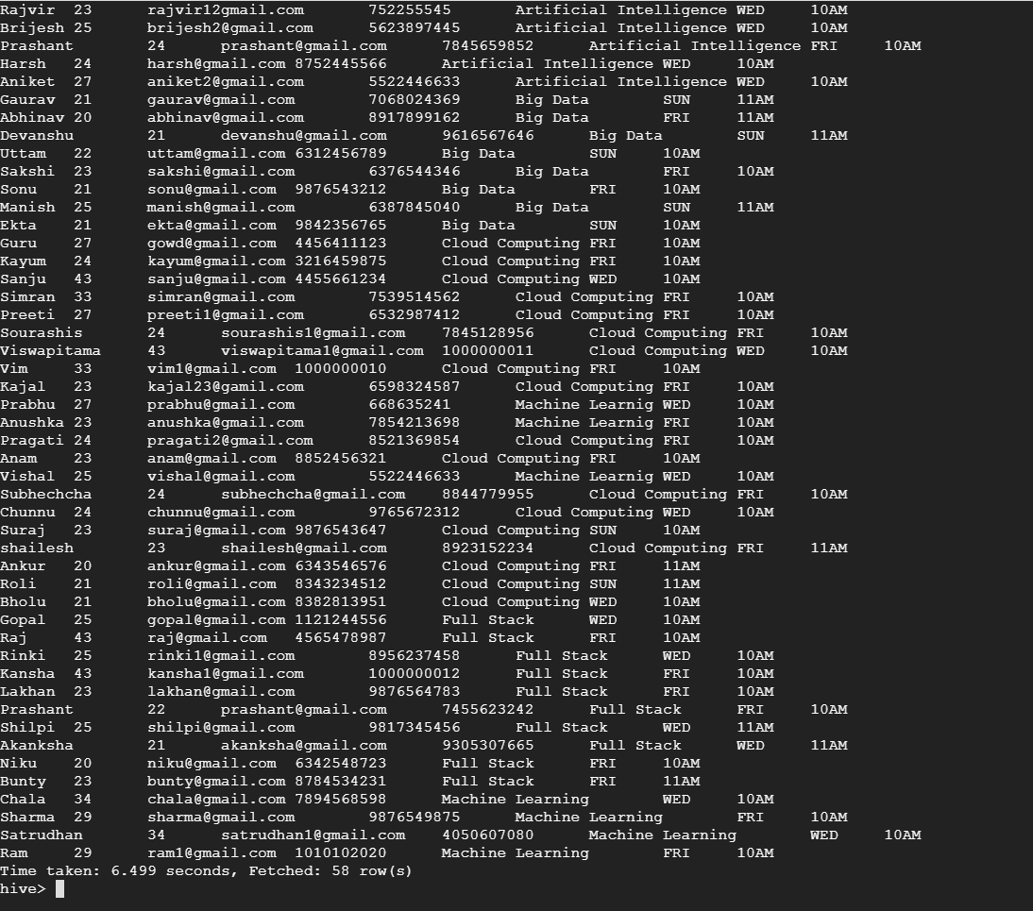
Weekday demo table

Slide 11
Weekend demo Table
Query:
create table weekend_demo(name string,age int,email string,phone string,course string,demo_day string,demo_time string) clustered by (course) into 5 buckets stored as orc tblproperties('transactional'='true');
We have used substr operator for extracting demo day and time from enquiry table where demoday is weekend.
Command for joining:
insert overwrite table weekend_demo select name,age,email,phone,course,substr(demo,4,3) as demo_day,substr(demo,8,4) as demo_time from enquiry where substr(demo,1,2)=='WE';

Slide 12
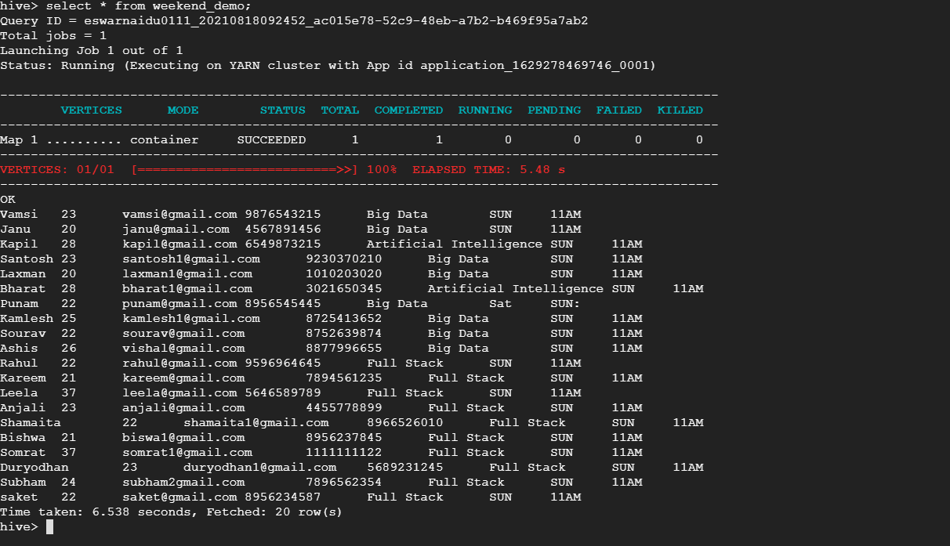
Weekend Demo Table

Slide 13
Demo Not Done Table
The data for table is taken from Enquiry table whose status is DND
create table demo_not_done(name string,age int,email string,phone string,course string,week string,demo_day string,demo_time string) clustered by (course) into 5 buckets stored as orc tblproperties('transactional'='true');
insert overwrite table demo_not_done select name,age,email,phone,course,case when substr(demo,1,2)=='WD' then 'WEEKDAYS' when substr(demo,1,2)=='WE' then 'WEEKEND' end,substr(demo,4,3) as demo_day,substr(demo,8,4) as demo_time from enquiry where status='DND';

Slide 14
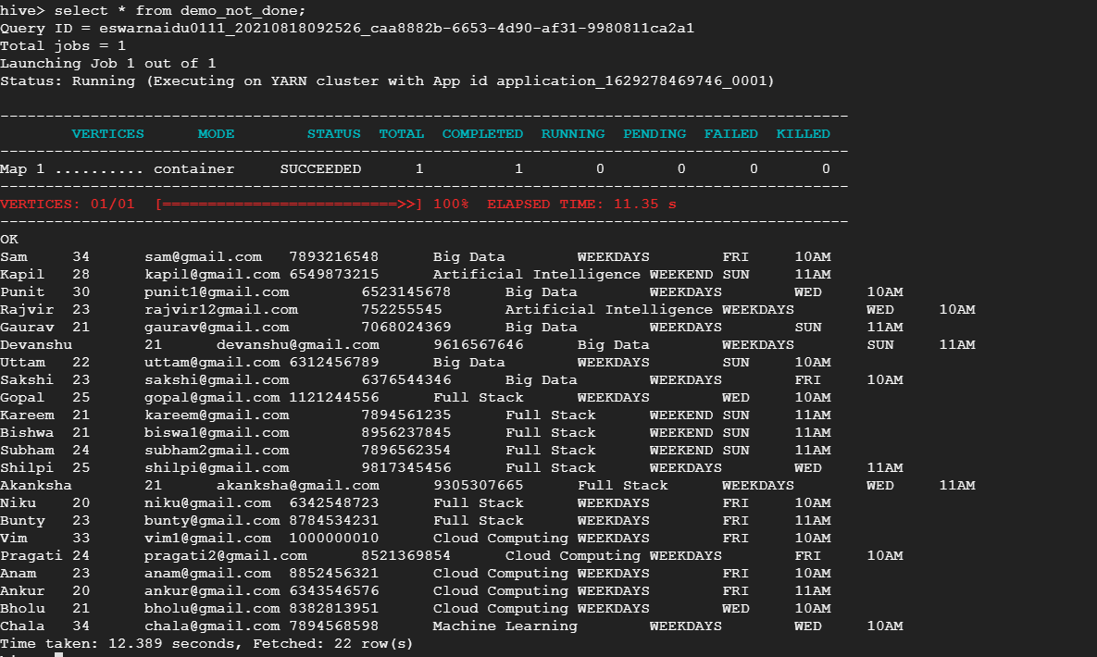
Demo Not Done Table

Slide 15
Weekdays Joining Table
create table weekdays_joining(name string,age int,email string,phone string,course string,fee int,discount int) clustered by(course) into 5 buckets stored as orc tblproperties('transactional'='true');
insert overwrite table weekdays_joining select name,age,email,phone,course,fee,discount from enquiry where status='EWD';

Slide 16
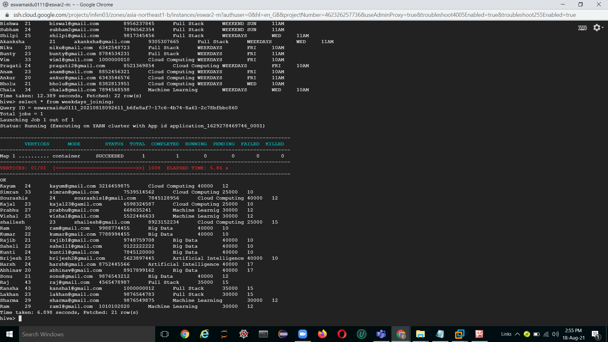
WeekDays Joining Table

Slide 17
WeekEnd Joining Table
create table weekend_joining(name string,age int,email string,phone string,course string,fee int,discount int) clustered by(course) into 5 buckets stored as orc tblproperties('transactional'='true');
insert overwrite table weekend_joining select name,age,email,phone,course,fee,discount from enquiry where status='EWE';

Slide 18
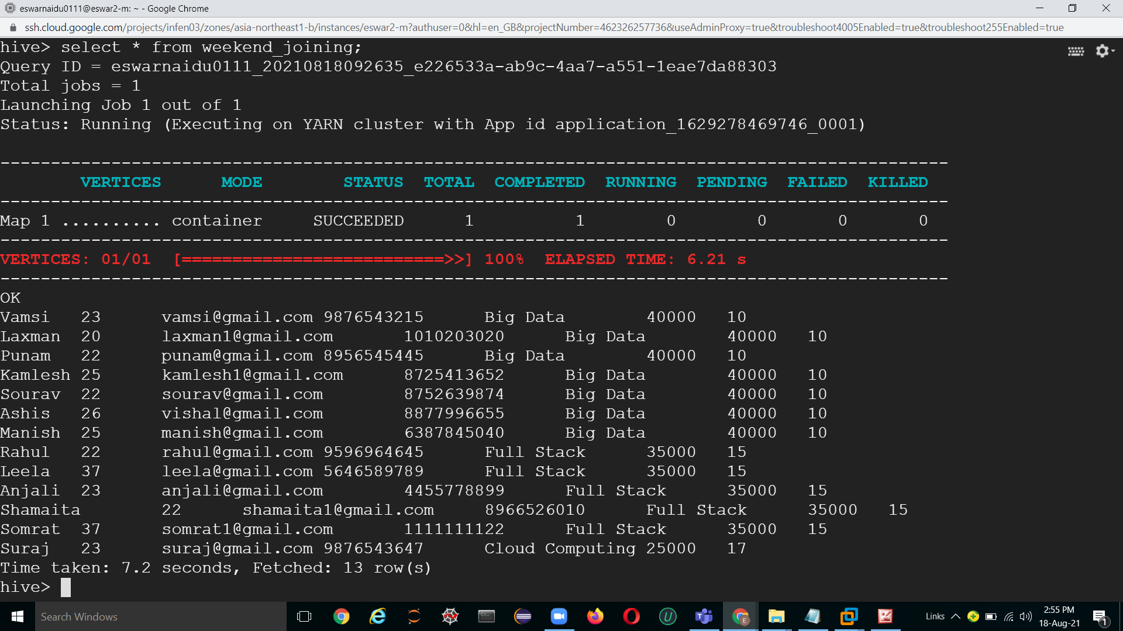
WeekEnd Joining Table

Slide 19
Not Joined Table
create table not_joined(name string,age int,email string,phone string,course string,fee int,discount int,type string) clustered by(course) into 5 buckets stored as orc tblproperties('transactional'='true');
insert overwrite table not_joined select name,age,email,phone,course,fee,discount,case when substr(demo,1,2)=='WD' then 'Weekdays' else 'Weekend' end from enquiry where status='NJ';

Slide 20
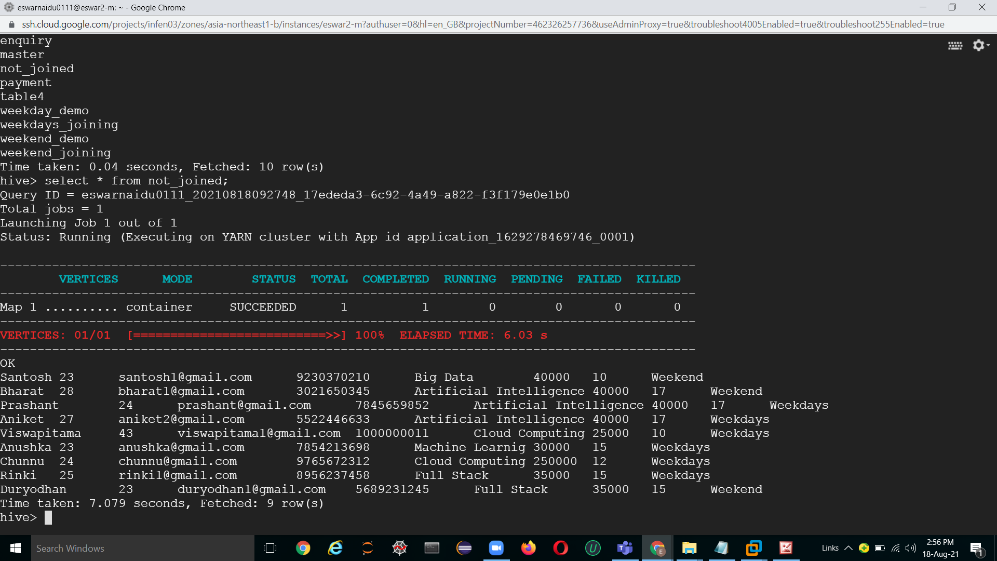
Not Joined Table

Slide 21
Payment Table
create table payment(name string,age int,email string,phone string,course string,type string,fee int) stored as orc tblproperties('transactional'='true');
insert overwrite table payment select name,age,email,phone,course,case when substr(demo,1,2)=='WD' then 'Weekdays' else 'Weekend' end,fee from enquiry where status='EWE' or status='EWD';
alter table payment add columns(paid int,mode string,no_of_install int,due_date string);
insert overwrite table payment select p.name, p.age, p.email, p.phone, p.course,p.type, p.fee,j.paid,j.mode,j.no_of_install,j.due_date from payment p left join table4 j on p.name=j.name;

Slide 22
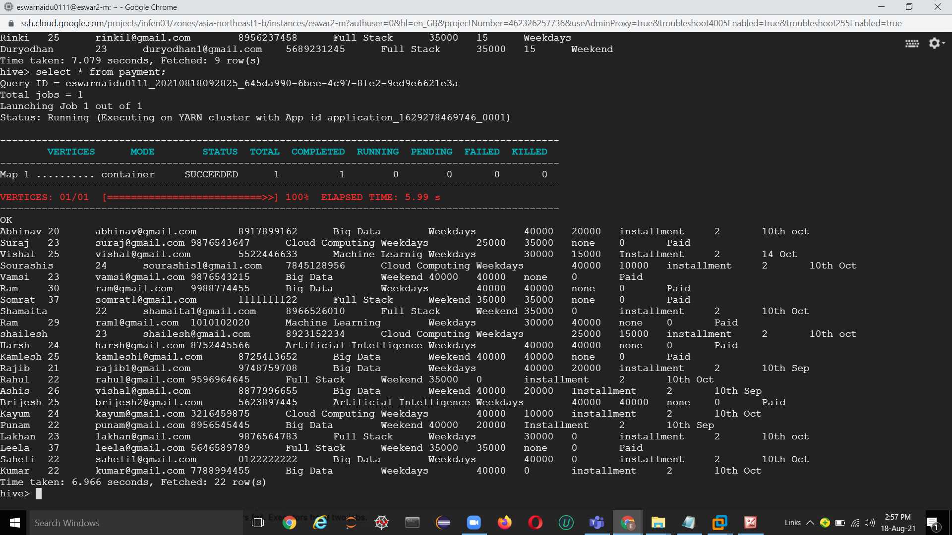
Payment Table

Slide 23
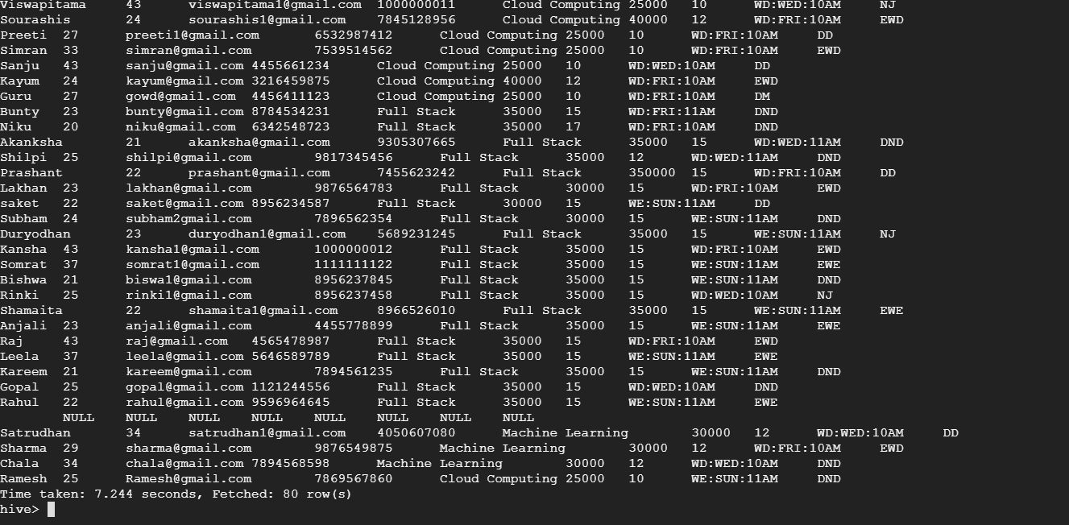
Update Record
insert into table enquiry values("Ramesh",25,"Ramesh@gmail.com",
'7869567860','Cloud Computing',25000,10,'WE:SUN:11AM','DND');

Slide 24
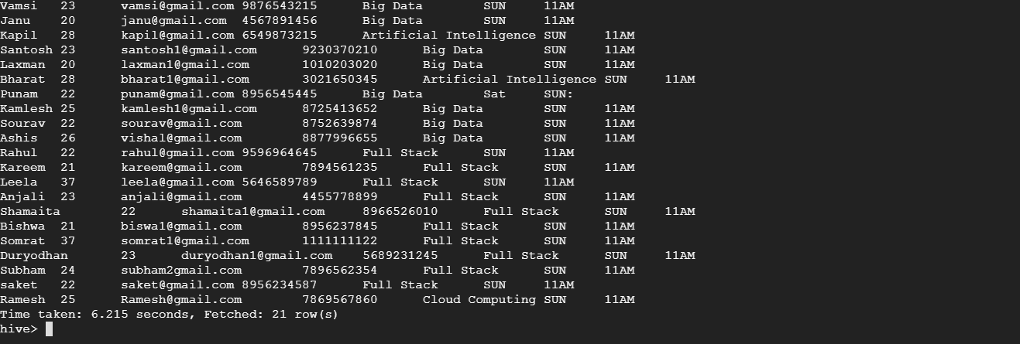
Upadte Weekend_Demo Table
insert into table Weekend_demo values("Ramesh",25,"Ramesh@gmail.com",
'7869567860','Cloud Computing','SUN','11AM');

Slide 25
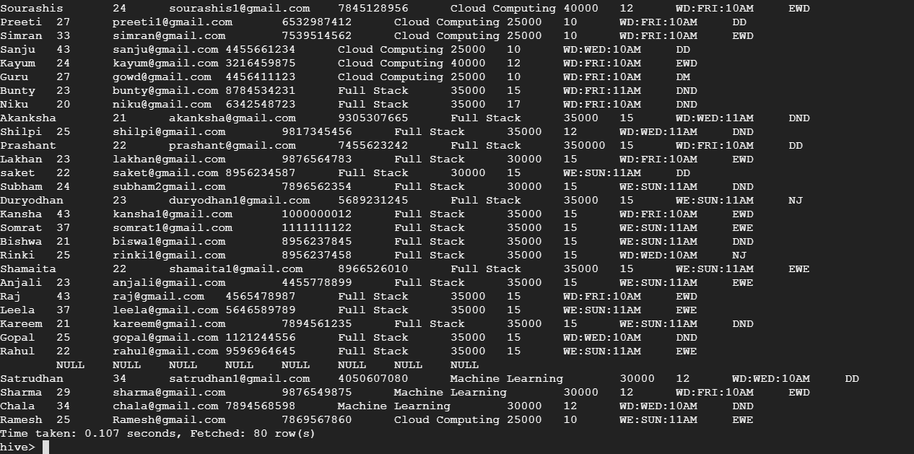
Update Student in Enquiry Table
update enquiry set status='EWE' where name='Ramesh';

Slide 26
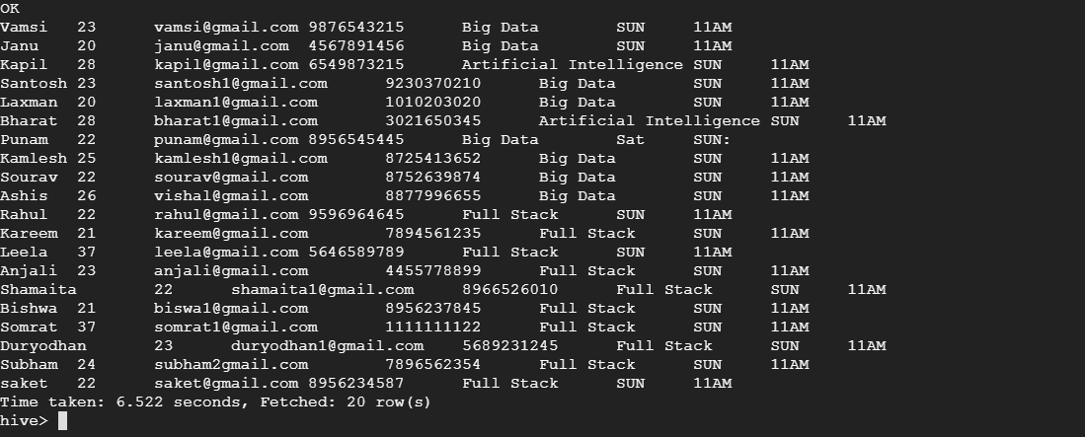
Deleting Student From Weekend_Demo Table
delete from Weekend_demo where name='Ramesh';

Slide 27
Thank You

